Slide 1

Support Vector Machine
Dr. Retno Kusumaningrum, S.Si., M.Kom.

Slide 2
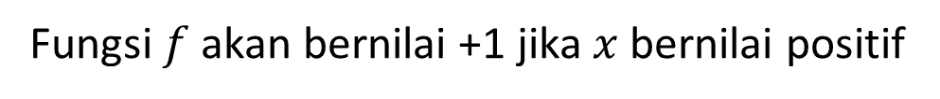

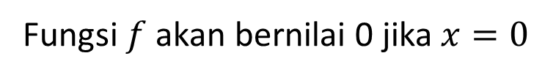
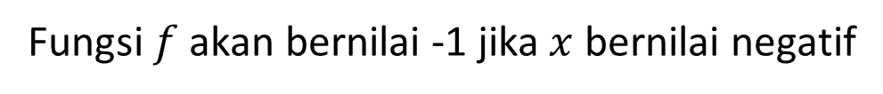
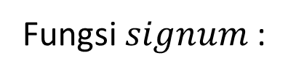
Linear Classifier
x
f
y^{est}
f(x,w,b) = sign(w. x - b)
Fungsi $signum$ :
$$f=sign\left(x\right)$$
Fungsi $f$ akan bernilai +1 jika $x$ bernilai positif
Fungsi $f$ akan bernilai -1 jika $x$ bernilai negatif
Fungsi $f$ akan bernilai 0 jika $x=0$

Slide 3
Linear Classifiers
denotes +1
denotes -1
How would you classify this data?

Slide 4
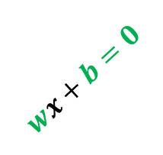


Linear Classifiers
denotes +1
denotes -1
$$wx+b>0$$
$$wx+b=0$$
How would you classify this data?
$$wx+b<0$$

Slide 5
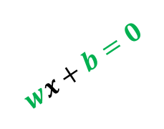
Linear Classifiers
denotes +1
denotes -1
$$wx+b>0$$
$$wx+b=0$$
How would you classify this data?
$$wx+b<0$$

Slide 6

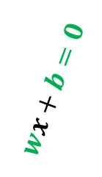

Linear Classifiers
$$wx+b=0$$
denotes +1
denotes -1
$$wx+b>0$$
How would you classify this data?
$$wx+b<0$$

Slide 7

Linear Classifiers
denotes +1
denotes -1
$$wx+b>0$$
Any of these would be fine..
..but which is best?
$$wx+b<0$$

Slide 8
Classifier Margin
Hyperplane = garis yang memisahkan kedua kelompok
denotes +1
denotes -1
Menentukan margin sebagai jarak antara hyperplane tersebut dengan pattern terdekat dari masing-masing class

Slide 9
Maximum Margin Classifier
denotes +1
denotes -1
The maximum margin linear classifier is the linear classifier with the maximum margin.
This is the simplest kind of SVM (Called an LSVM)
Linear SVM

Slide 10
Maximum Margin Classifier
denotes +1
denotes -1
The maximum margin linear classifier is the linear classifier with the maximum margin.
This is the simplest kind of SVM (Called an LSVM)
Support Vectors are those datapoints that the margin pushes up against
Linear SVM

Slide 11
Why Maximum Margin?
Intuitively this feels safest.
Implies that only support vectors are important; other training examples are ignorable.
Empirically it works very very well.
f(x,w,b) = sign(w. x - b)
denotes +1
denotes -1
Support Vectors are those datapoints that the margin pushes up against

Slide 12
ANOTHER EXAMPLE

Slide 13
Support Vector Machines
Find a linear hyperplane (decision boundary) that will separate the data

Slide 14
Support Vector Machines
One Possible Solution

Slide 15
Support Vector Machines
Another possible solution

Slide 16
Support Vector Machines
Other possible solutions

Slide 17
Support Vector Machines
Which one is better? B1 or B2?
How do you define better?

Slide 18
Support Vector Machines
Find hyperplane maximizes the margin => B1 is better than B2

Slide 19
MATHEMATICAL CONCEPT

Slide 20
Specifying a line and margin
Plus-Plane
“Predict Class = +1” zone
Classifier Boundary
Minus-Plane
“Predict Class = -1” zone
How do we represent this mathematically?
…in m input dimensions?

Slide 21
Specifying a line and margin
Plus-Plane
“Predict Class = +1” zone
Classifier Boundary
Minus-Plane
“Predict Class = -1” zone
wx+b=1
wx+b=0
wx+b=-1
Plus-plane = { x : w . x + b = +1 }
Minus-plane = { x : w . x + b = -1 }
Classify as.. | +1 | if | w . x + b >= 1
 | -1 | if | w . x + b <= -1
 | Universe explodes | if | -1 < w . x + b < 1

Slide 22
Computing the margin width
M = Margin Width
“Predict Class = +1” zone
How do we compute M in terms of w and b?
“Predict Class = -1” zone
wx+b=1
wx+b=0
wx+b=-1
Plus-plane = { x : w . x + b = +1 }
Minus-plane = { x : w . x + b = -1 }
Claim: The vector w is perpendicular (tegak lurus) to the Plus Plane. Why?

Slide 23
Computing the margin width
M = Margin Width
“Predict Class = +1” zone
How do we compute M in terms of w and b?
“Predict Class = -1” zone
wx+b=1
wx+b=0
wx+b=-1
Plus-plane = { x : w . x + b = +1 }
Minus-plane = { x : w . x + b = -1 }
Claim: The vector w is perpendicular to the Plus Plane. Why?
Let u and v be two vectors on the Plus Plane. What is w . ( u – v ) ?
And so of course the vector w is also perpendicular to the Minus Plane
w . ( u – v )=0 ➔ orthogonal

Slide 24
Computing the margin width
x⁺
M = Margin Width
“Predict Class = +1” zone
How do we compute M in terms of w and b?
x⁻
“Predict Class = -1” zone
wx+b=1
wx+b=0
wx+b=-1
Plus-plane = { x : w . x + b = +1 }
Minus-plane = { x : w . x + b = -1 }
The vector w is perpendicular to the Plus Plane
Let x⁻ be any point on the minus plane
Let x⁺ be the closest plus-plane-point to x⁻.
Any location in ^{m}: not necessarily a datapoint
Any location in R^{m}: not necessarily a datapoint

Slide 25
Computing the margin width
x⁺
M = Margin Width
“Predict Class = +1” zone
How do we compute M in terms of w and b?
x⁻
“Predict Class = -1” zone
wx+b=1
wx+b=0
wx+b=-1
Plus-plane = { x : w . x + b = +1 }
Minus-plane = { x : w . x + b = -1 }
The vector w is perpendicular to the Plus Plane
Let x⁻ be any point on the minus plane
Let x⁺ be the closest plus-plane-point to x⁻.
Claim: x⁺ = x⁻ + λ w for some value of λ. Why?

Slide 26
Computing the margin width
x⁺
M = Margin Width
“Predict Class = +1” zone
The line from x⁻ to x⁺ is perpendicular to the planes.
So to get from x⁻ to x⁺ travel some distance in direction w.
How do we compute M in terms of w and b?
x⁻
“Predict Class = -1” zone
wx+b=1
wx+b=0
wx+b=-1
Plus-plane = { x : w . x + b = +1 }
Minus-plane = { x : w . x + b = -1 }
The vector w is perpendicular to the Plus Plane
Let x⁻ be any point on the minus plane
Let x⁺ be the closest plus-plane-point to x⁻.
Claim: x⁺ = x⁻ + λ w for some value of λ. Why?

Slide 27
Computing the margin width
x⁺
M = Margin Width
“Predict Class = +1” zone
x⁻
“Predict Class = -1” zone
wx+b=1
wx+b=0
wx+b=-1
What we know:
w . x⁺ + b = +1
w . x⁻ + b = -1
x⁺ = x⁻ + λ w
|x⁺ - x⁻ | = M
It’s now easy to get M in terms of w and b

Slide 28
Computing the margin width
x⁺
M = Margin Width
“Predict Class = +1” zone
x⁻
“Predict Class = -1” zone
wx+b=1
wx+b=0
w . (x ⁻ + λ w) + b = 1
=>
w . x ⁻ + b + λ w .w = 1
=>
-1 + λ w .w = 1
=>
wx+b=-1
What we know:
w . x⁺ + b = +1
w . x⁻ + b = -1
x⁺ = x⁻ + λ w
|x⁺ - x⁻ | = M
It’s now easy to get M in terms of w and b

Slide 29
Computing the margin width
x⁺
M = Margin Width =
“Predict Class = +1” zone
x⁻
“Predict Class = -1” zone
wx+b=1
wx+b=0
M = |x⁺ - x⁻ | =| λ w |=
wx+b=-1
What we know:
w . x⁺ + b = +1
w . x⁻ + b = -1
x⁺ = x⁻ + λ w
|x⁺ - x⁻ | = M

Slide 30
Learning the Maximum Margin Classifier
x⁺
M = Margin Width =
“Predict Class = +1” zone
x⁻
“Predict Class = -1” zone
wx+b=1
wx+b=0
wx+b=-1
Given a guess of w and b we can
Compute whether all data points in the correct half-planes
Compute the width of the margin
So now we just need to write a program to search the space of w’s and b’s to find the widest margin that matches all the datapoints. How?
Quadratic Programming

Slide 31
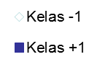
Contoh Studi Kasus
Contoh SVM Linier pada dataset berikut :
Tentukan Hyperplanenya !
Bentuk Visualisasi data :
x₁ | x₂ | Kelas (y) | Support Vector (SV)
1 | 1 | 1 | 1
1 | -1 | -1 | 1
-1 | 1 | -1 | 1
-1 | -1 | -1 | 0

Slide 32
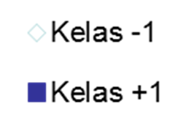

Contoh Studi Kasus 1 (Cont.)
Contoh SVM Linier :
Formulasi yang digunakan adalah sebagai berikut :
Meminimalkan nilai :
Syarat :
x₁ | x₂ | Kelas (y)
1 | 1 | 1
1 | -1 | -1
-1 | 1 | -1
-1 | -1 | -1

Slide 33
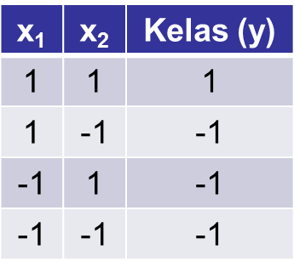
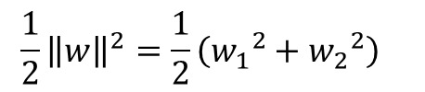
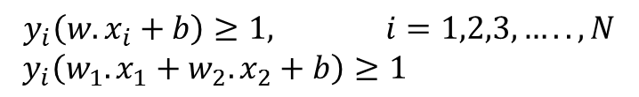
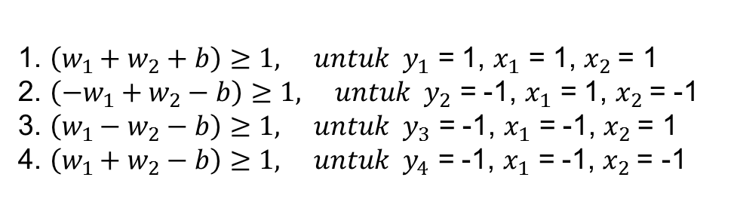
Contoh Studi Kasus 1 (Cont.)
Karena ada dua fitur (x₁ dan x₂), maka w juga akan memiliki 2 fitur (w₁ dan w₂).
Formulasi yang digunakan adalah sebagai berikut :
Meminimalkan nilai margin :
Syarat :
Sehingga didapatkan beberapa persamaan berikut :

Slide 34
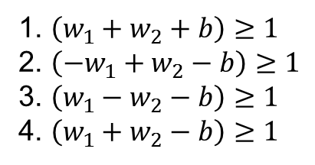
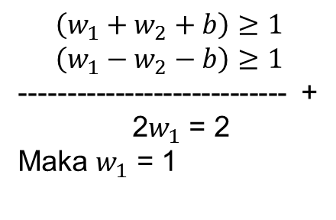
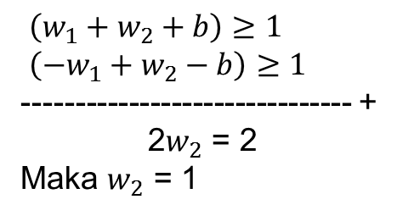
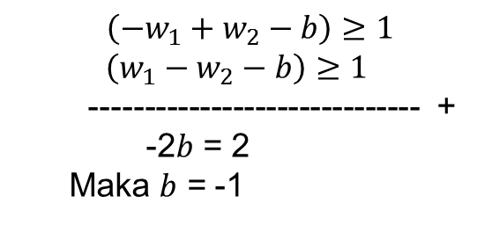
Contoh Studi Kasus 1 (Cont.)
Didapatkan beberapa persamaan berikut :
Menjumlahkan persamaan (1) dan (2) :
Sehingga didapatkan persamaan hyperplane :
w₁x₁ + w₂x₂ + b = 0
x₁ + x₂ - 1 = 0
x₂ = 1 - x₁
Menjumlahkan persamaan (1) dan (3) :
Menjumlahkan persamaan (2) dan (3) :

Slide 35
Contoh Studi Kasus 1 (Cont.)
Visualisasi garis hyperplane (sebagai fungsi klasifikasi) :
w₁x₁ + w₂x₂ + b = 0
x₁ + x₂ - 1 = 0
x₂ = 1 - x₁
x₂ = 1 - x₁
x₁ | x₂ = 1 – x₁
-2 | 3
-1 | 2
0 | 1
1 | 0
2 | -1

Slide 36
Contoh Studi Kasus 1 (Cont.)
Misalkan diketahui data uji/ data testing berikut :
Diketahui : f(x) = x₁ + x₂ – 1
Kelas = sign(f(x))
x₂ = 1 - x₁
No | Data Uji |  | Hasil Klasifikasi
 | x₁ | x₂ | Kelas = sign(x₁ + x₂ - 1)
1 | 1 | 5 | sign (1 + 5 - 1) = +1
2 | -1 | 4 | sign (-1 + 4 - 1) = +1
3 | 0 | 7 | sign (0 + 7 - 1) = +1
4 | -9 | 0 | sign (-9 + 0 - 1) = -1
5 | 2 | -2 | sign (2 - 2 - 1) = -1

Slide 37
NON LINEAR SVM

Slide 38
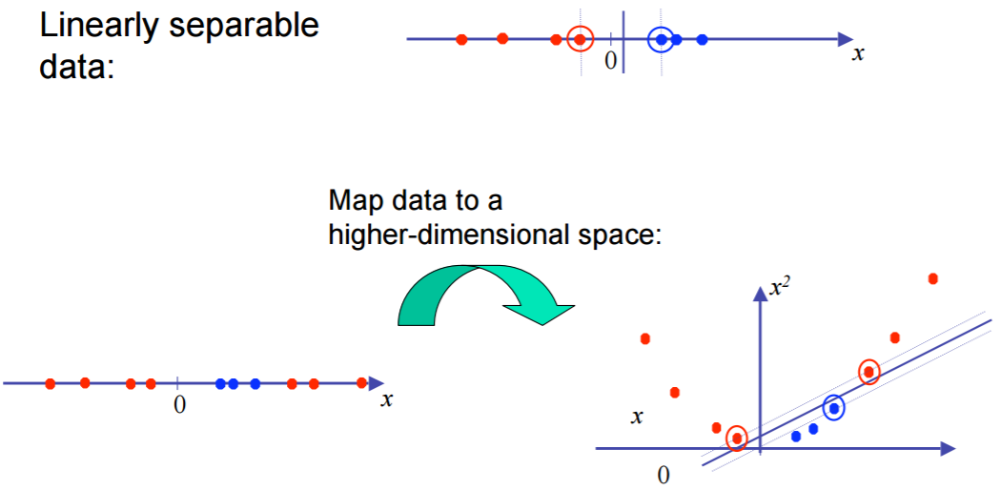
Non Linear SVMs

Slide 39
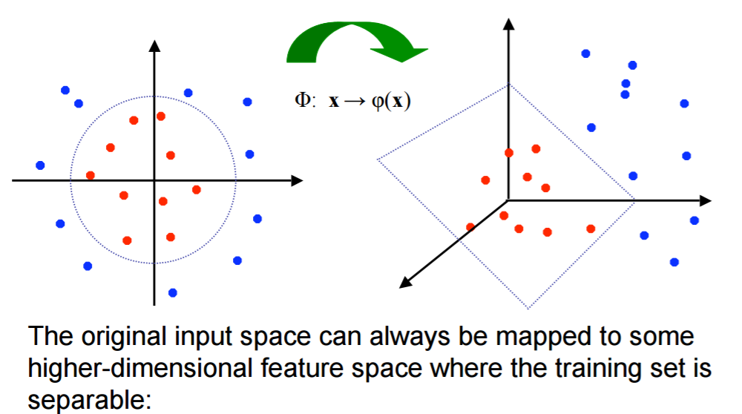
Non Linear SVMs : Feature Space

Slide 40
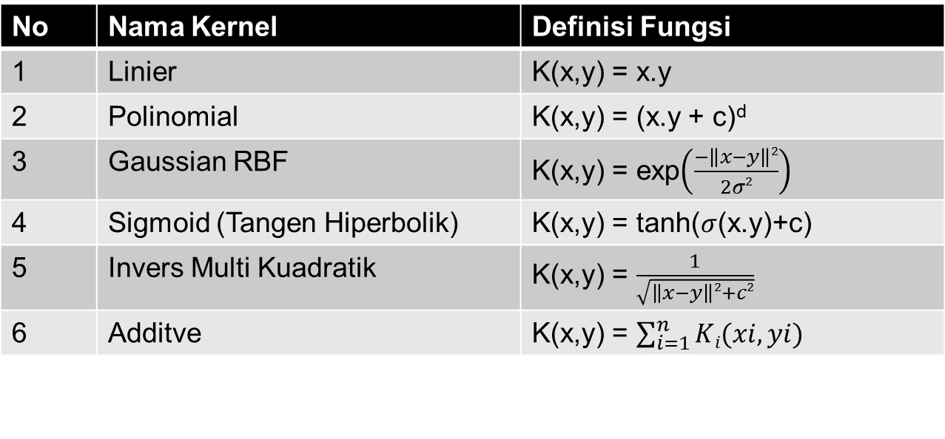
Model SVM (Cont.)
Beberapa Macam Fungsi Kernel Support Vector Machine (SVM) :
Kernel Linier digunakan ketika data yang akan diklasifikasi dapat terpisah dengan sebuah garis/hyperplane.
Kernel non-Linier digunakan ketika data hanya dapat dipisahkan dengan garis lengkung atau sebuah bidang pada ruang dimensi tinggi (Kernel Trik, No.2 sampai 6).
No | Nama Kernel | Definisi Fungsi
1 | Linier | K(x,y) = x.y
2 | Polinomial of degree d | K(x,y) = (x.y)^{d}
3 | Polinomial of degree up to d | K(x,y) = (x.y + c)^{d}
4 | Gaussian RBF
5 | Sigmoid (Tangen Hiperbolik)
6 | Invers Multi Kuadratik
7 | Additive
Notes:
Additive Kernel yang digunakan di paper reference hanya diterapkan pada kasus dengan hyperplane Linier.
Konsep Additive kernel adalah menambahkan beberapa hasil K(x,y) dari 2 kernel atau lebih.

Slide 41
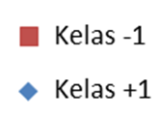
Contoh Studi Kasus 2
Contoh SVM Non Linier pada dataset berikut :
Bentuk Visualisasi data :
x₁ | x₂ | Kelas (y) | Support Vector (SP)
1 | 1 | -1 | 1
1 | -1 | 1 | 1
-1 | 1 | 1 | 1
-1 | -1 | -1 | 1

Slide 42
Contoh Studi Kasus 2 (Cont.)
Contoh SVM Non Linier :
Karena ada dua fitur (x₁ dan x₂), dan kelompok datanya tidak linear, maka digunakan fungsi kernel. Misal menggunakan fungsi kernel polynomial ordo 2, yaitu : K(x,y) = (x.y + c)^{d} dengan c = 1 dan d = 2.
Fungsi kernel dituliskan kembali menjadi berikut : K(x,x_{i}) = (x^{T}.x_{i} + 1)² dengan
Menghitung matrik kernel K : K(x,x_{i}) = ᶲ(x).ᶲ(x_{i})
x₁ | x₂ | Kelas (y)
1 | 1 | -1
1 | -1 | 1
-1 | 1 | 1
-1 | -1 | -1

Slide 43
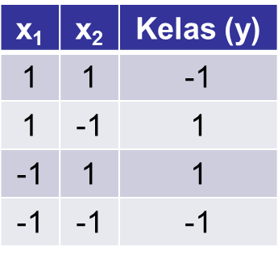
Contoh Studi Kasus 2 (Cont.)
Fungsi kernel dituliskan kembali menjadi berikut : K(x,x_{i}) = (x^{T}.x_{i} + 1)² dengan
Menghitung matrik kernel K(x,x_{i}) = ᶲ(x).ᶲ(x_{i})
Misal, Menghitung K(u,z) : dengan u=(1,1) dan z=(1,-1)
k(U=(1,1),Z=(1,-1)) = (((U₁.Z₁)+(U₂.Z₂))+1)² = ((U₁.Z₁)+(U₂.Z₂))²+2((U₁.Z₁)+(U₂.Z₂)).1 + 1²
= (U₁.Z₁)² + 2(U₁.Z₁)(U₂.Z₂) + (U₂.Z₂)² + 2(U₁.Z₁) + 2(U₂.Z₂) + 1

Slide 44
Contoh Studi Kasus 2 (Cont.)
Fungsi kernel dituliskan kembali menjadi berikut : K(x,x_{i}) = (x^{T}.x_{i} + 1)² dengan
Menghitung matrik kernel K(x,x_{i}) = ᶲ(x).ᶲ(x_{i})
Misal, Menghitung K(u,z) : dengan u=(1,1) dan z=(1,-1)
k(U=(1,1),Z=(1,-1)) = (((U₁.Z₁)+(U₂.Z₂))+1)² = ((U₁.Z₁)+(U₂.Z₂))²+2((U₁.Z₁)+(U₂.Z₂)).1 + 1²
= (U₁.Z₁)² + 2(U₁.Z₁)(U₂.Z₂) + (U₂.Z₂)² + 2(U₁.Z₁) + 2(U₂.Z₂) + 1

Slide 45
Contoh Studi Kasus 2 (Cont.)
Misal, Menghitung K(u,z) : dengan u=(1,1) dan z=(1,-1)
k(U=(1,1),Z=(1,-1)) = (((1.1)+(1.(-1)))+1)² = ((1.1)+(1.(-1)))²+2((1.1)+(1.(-1))).1 + 1²
= (1.1)² + 2(1.1)(1.(-1)) + (1.(-1))² + 2(1.1) + 2(1.(-1)) + 1
= 1 - 2 + 1 + 2 - 2 + 1 = 1

Slide 46
Contoh Studi Kasus 2 (Cont.)
Menghitung matrik kernel K(x,x_{i}) = ᶲ(x).ᶲ(x_{i})
x₁ | x₁ | K(1,1) = (x₁.x₁ + 1)² = (1.1 + 1.1 +1)² = 3² = 9
 | x₂ | K(1,2) = (x₁.x₂ + 1)² = (1.1 + 1.(-1) +1)² = 1² = 1
 | x₃ | K(1,3) = (x₁.x₃ + 1)² = (1.(-1) + 1.1 +1)² = 1² = 1
 | x₄ | K(1,4) = (x₁.x₄ + 1)² = (1.(-1) + 1.(-1) +1)² = (-1)² = 1
x₂ | x₁ | K(2,1) = (x₂.x₁ + 1)² = (1.1 + (-1).1 +1)² = 1² = 1
 | x₂ | K(2,2) = (x₂.x₂ + 1)² = (1.1 + (-1).(-1) +1)² = 3² = 9
 | x₃ | K(2,3) = (x₂.x₃ + 1)² = (1.(-1) + (-1).1 +1)² = 1² = 1
 | x₄ | K(2,4) = (x₂.x₄ + 1)² = (1.(-1) + (-1).(-1) +1)² = 1² = 1
X₃ | x₁ | K(3,1) = (x₃.x₁ + 1)² = ((-1).1 + 1.1 +1)² = 1² = 1
 | x₂ | K(3,2) = (x₃.x₂ + 1)² = ((-1).1 + 1.(-1) +1)² = 1² = 1
 | x₃ | K(3,3) = (x₃.x₃ + 1)² = ((-1).(-1) + 1.1 +1)² = 3² = 9
 | x₄ | K(3,4) = (x₃.x₄ + 1)² = ((-1).(-1) + 1.(-1) +1)² = 1² = 1
x₄ | x₁ | K(4,1) = (x₄.x₁ + 1)² = ((-1).1 + (-1).1 +1)² = 1² = 1
 | x₂ | K(4,2) = (x₄.x₂ + 1)² = ((-1).1 + (-1).(-1) +1)² = 1² = 1
 | x₃ | K(4,3) = (x₄.x₃ + 1)² = ((-1).(-1) + (-1).1 +1)² = 1² = 1
 | X₄ | K(4,4) = (x₄.x₄ + 1)² = ((-1).(-1) + (-1).(-1) +1)² = 3² = 9

Slide 47
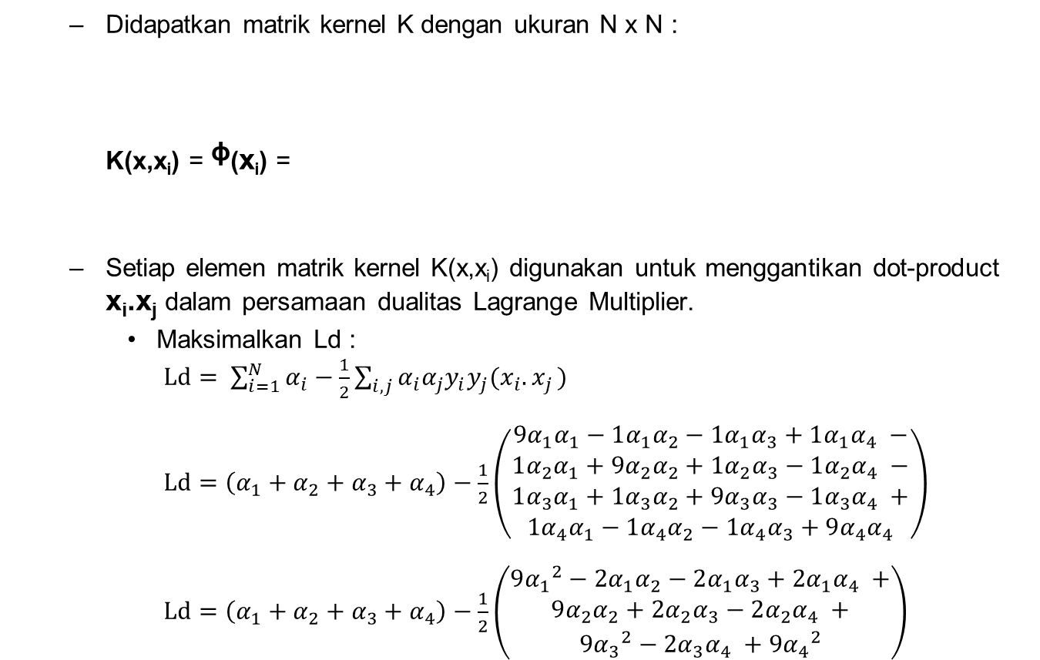
Contoh Studi Kasus 2 (Cont.)
9 | 1 | 1 | 1
1 | 9 | 1 | 1
1 | 1 | 9 | 1
1 | 1 | 1 | 9

Slide 48
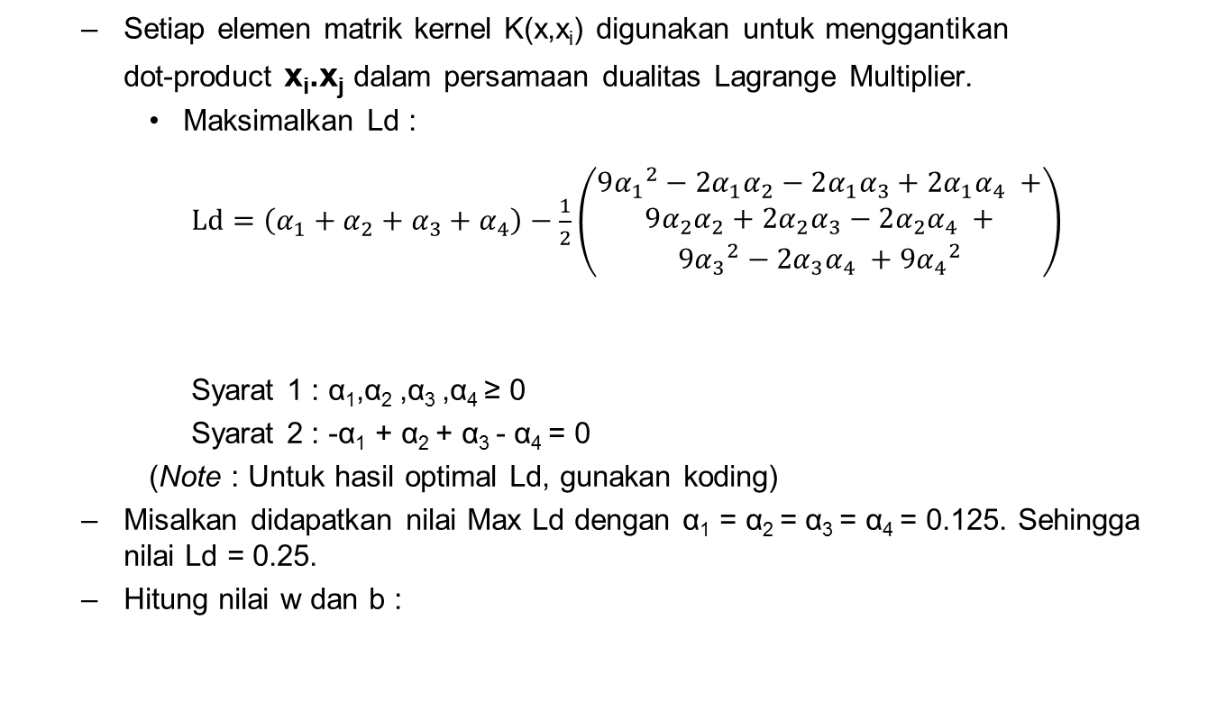
Contoh Studi Kasus 2 (Cont.)
dimana adalah nilai pada dimensi ke-1 pada data ke-i.

Slide 49
Contoh Studi Kasus 2 (Cont.)
- Hitung nilai w dan b :
dimana adalah nilai pada dimensi ke-1 pada data ke-i.

Slide 50
Contoh Studi Kasus 2 (Cont.)
Misalkan didapatkan nilai Max Ld dengan α₁ = α₂ = α₃ = α₄ = 0.125.
Sehingga nilai Ld = 0.25.
Hitung nilai w dan b :
Pilih salah satu Support Vector dari Kelas “+1” dan “-1” untuk menghitung nilai b.

Slide 51
Contoh Studi Kasus 2 (Cont.)
Misalkan didapatkan nilai Max Ld dengan α₁ = α₂ = α₃ = α₄ = 0.125.
Sehingga nilai Ld = 0.25.
Hitung nilai w dan b :
Pilih salah satu Support Vector dari Kelas “+1” dan “-1” untuk menghitung nilai b.

Slide 52
Contoh Studi Kasus 2 (Cont.)
Setelah didapatkan nilai w dan b :
Maka model SVM siap digunakan untuk proses klasifikasi.
Misalkan data uji/ data test x_{t} = (1,5) maka K(x_{i},x_{t}) = ᶲ(x_{i}).ᶲ(x_{t})
x_{t}=(1,5) | x₁ | K(1,t) = (x₁.x_{t} + 1)² = (1.1 + 5.1 +1)² = 7² = 49 | (-0.125)(49)
 | x₂ | K(2,t) = (x₂.x_{t} + 1)² = (1.1 + 5.(-1) +1)² = 3² = 9 | (0.125)(9)
 | x₃ | K(3,t) = (x₃.x_{t} + 1)² = (1.(-1) + 5.1 +1)² = 5² = 25 | (0.125)(25)
 | x₄ | K(4,t) = (x₄.x_{t} + 1)² = (1.(-1) + 5.(-1) +1)² = (-5)² = 25 | (-0.125)(25)
+
-5
Jadi data x_{t} = (1,5) tersebut masuk ke kelas negatif.

